Slide 1
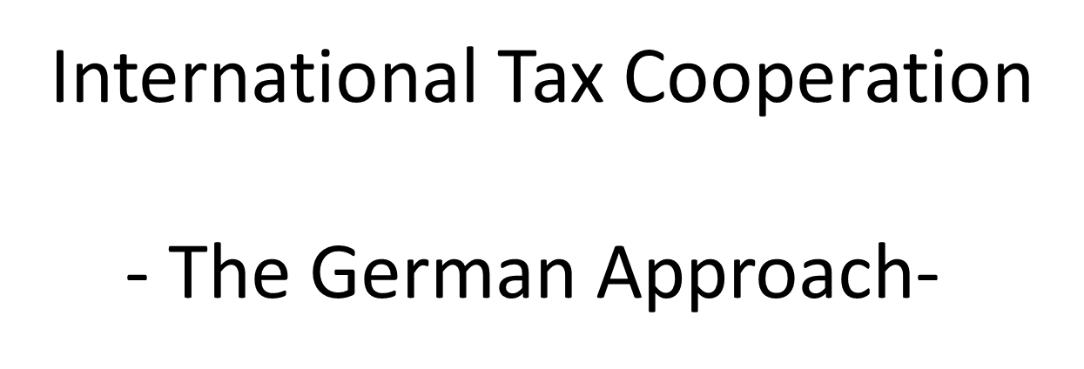
by
Michael Sell M. A.
Attorney – Certified Tax Advisor – Historian
Disclaimer: Since I am retired I do not speak on behalf of any German authority
International Tax Cooperation

Slide 2
Germany´s Basic Economic Prerequisites
1
82 million citizen
Densely populated
No illiteracy
No significant mineral resources
no priority destination for international tourists for vacation (usually short trips to Berlin etc.)
No top international finance industry hub (might change after Brexit)
Germany must rely on industrial production, engineering, innovation and worldwide exports (licences – heavy industry – cars)

Slide 3
German Tax policy concerning DTA
1
More than 90 Double Tax Agreements (DTA)
Emphasis on avoiding Double Taxation and Double Non-Taxation (!) (i.e. White Income or Double Depriciation in various juristictions)
Germany is interested in concluding additional DTA (ongoing negotiations Ruanda; Angola; Ethopia)
Eye level negotiations based on the OECD model and the German DTA model as a starting point (!)
German DTA model (English) https://www.bundesfinanzministerium.de/Content/DE/Standardartikel/Themen/Steuern/Internationales_Steuerrecht/Allgemeine_Informationen/2013-08-22-Verhandlungsgrundlage-DBA-englisch.html
Important to avoid White Income: subject to tax clauses – remittance base clauses – switch over clauses

Slide 4
German Tax Policy Principles
1
Place of engineering and production is the main value creator
Pure market access without a permanent establishment is not a valid link for income or corporation tax on sale profits in the country of consumption (only VAT or custom tariffs)
The OECD is the international tax standard setter and not the United Nations, because the UN has other responsibilities and no experience in this field.
Despite the variety of domestic tax systems the international tax issues (thin capitalisation, interest deduction limitation schemes, royalty limitation schemes, CFC problems) are the same and should be discussed in an experienced organisation, that has offered proven tools for solution.
The implementation is purely subject to national law or agreed treaties among the jurisdictions.

Slide 5
German Tax Policy (International Data Exchange)
1
Data Exchange upon request based on bilateral Double Tax Agreements (DTA)
Data Exchange based on Foreign Asset Tax Compliance Act (USA)
Automatic Exchange of financial information in tax matters (over 100 countries signed that already) – Initiative introduced by former British finance minister George Osborne and German finance minister Dr. Schäuble (Berlin Conference 2014)
Automatic Exchange of Information (AEOI) Global Forum on Transparency and Exchange of Information for Tax Purposes in the area of the automatic exchange of information, in particular with respect to the Common Reporting Standard. http://www.oecd.org/tax/automatic-exchange/
Country by Country Reporting among tax administrations – not general public (otherwise „no tit for tat“ situation)

Slide 6
Federal Central Tax Office (Bonn)
1
Data Exchange upon request based on bilateral Double Tax Agreements (DTA) inbound and outbound
Negotiation for Advanced Pricing Agreements in major international investments between various jurisdictions
Tax Inspectors without Borders (= joint audits – bi- or multilateral - together with other tax inspectors at the same time) to collect undisputed data among tax authorities
Settlement procedures among different international tax authorities based on a DTA (no mandatory binding settlement requirements)
No mandatory (!) alternative dispute resolution system (i.e. arbitration court or international tax court)

Slide 7
Thank you for your attention!
Contact Info
Email: m.sell@seitzpartner.de
Cell: 0049 178 7074959
Website: https://www.seitzpartner.de/team/michael-sell/

