Slide 1
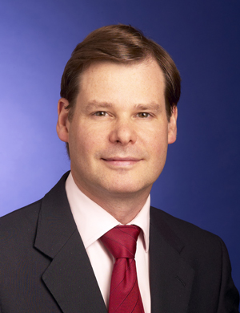
Head of Global Tax Policy
Curriculum Vitae
Name | Chris Morgan
Position | Head of Global Tax Policy
Qualifications | Qualified as a solicitor in 1991 (but longer practicing as a solicitor)
Experience | Chris became Head of Tax Policy for KPMG UK in 2011. In this role he was a regular commentator in the press, as well as on radio and TV, led discussions on various representations with HMRC/HMT. In 2014 Chris spearheaded KPMG UK’s Responsible Tax for the Common Good initiative. In September 2016 Chris took on the role of Head of Global Tax Policy. As part of this role he runs the global Responsible Tax Programme (see www.responsibletax.kpmg.com) which brings all stakeholders into a constructive debate about how to make tax systems work for all. Chris’ background is in international tax in which he has over 25 years experience. Chris is a member of the UN Sub-committee on Environmental Taxes.
Contact | Tel: + 44 (0)20 7694 1714 Mobile: + (0)77 Email: christopher.morgan@kpmg.co.uk

